Slide 1
Cerebellar Ataxia
Dr. Nawaj Pathan
Dept of Neurophysiotherapy
MGM Institute of Physiotherapy
Chh. Sambhajinagar

Slide 2
Contents
Introduction
Functional role of cerebellum
Etiology
Clinical signs
Investigations
Management

Slide 3
Introduction
Ataxia means ‘not ordered’. term used to describe a no. of abnormal movements that may occur during the execution voluntary movements.
This includes incoordination, delay in movements, dysmetria(inaccuracy in achieving target),disdidokinesia (difficulty in performing movements of constant force & rhythm) & tremor.
Control of movements is distributed throughout the central nervous system(CNS)

Slide 4
The cerebellum has part to play within this distributed system by functioning closely with other parts of the CNS- motor cortex, basal ganglia, vestibular system & spinal motor system.
The main role of cerebellum is concerned with the-
1. timing
2.coordination & integration of movements, including eye movements & Speech.
Therefore lesions affecting the cerebellum would results in a disorder of movements, coordination often termed as-Cerebellar Ataxia

Slide 5
Often it may also associated with postural unsteadiness,in-cordination with other possible sign- ‘Titubation/ Tibulation’, nystagmus.
The characteristic of movement disorders resulting from cerebellar dysfunction have been described in early 20th century by Gordon Holmes.

Slide 6
Functional Role of Cerebellum
Although cerebellum constitute about 10% of the brain’s total volume; it contains more than half of the total no of neurons in the brain.
Cerebellum regulates vestibular, spinal & cortical mechanisms by means of reciprocal neuronal connections.
Structurally cerebellum composed of main 2 parts- cerebellar cortex & deep cerebellar nuclei.

Slide 7
These parts receives afferent pathways from other parts of CNS, mainly the cerebral cortex.
The efferent pathways that leave the cerebellum mainly arise from the deep nuclei, after receiving the outputs from cerebellar cortex projects back to cerebral cortex & other parts of CNS.

Slide 8
The cerebellum sends no pathways directly to the spinal cord but participates in 3 main functions i.e. vestibulo-cerebellar- modulates postural balance, eye movements, spino-cerebellar modulates muscle tone, posture & locomotion.
The cerebro-cerebellar system thought to play a role in regulating skilled movements, motor planning.

Slide 9
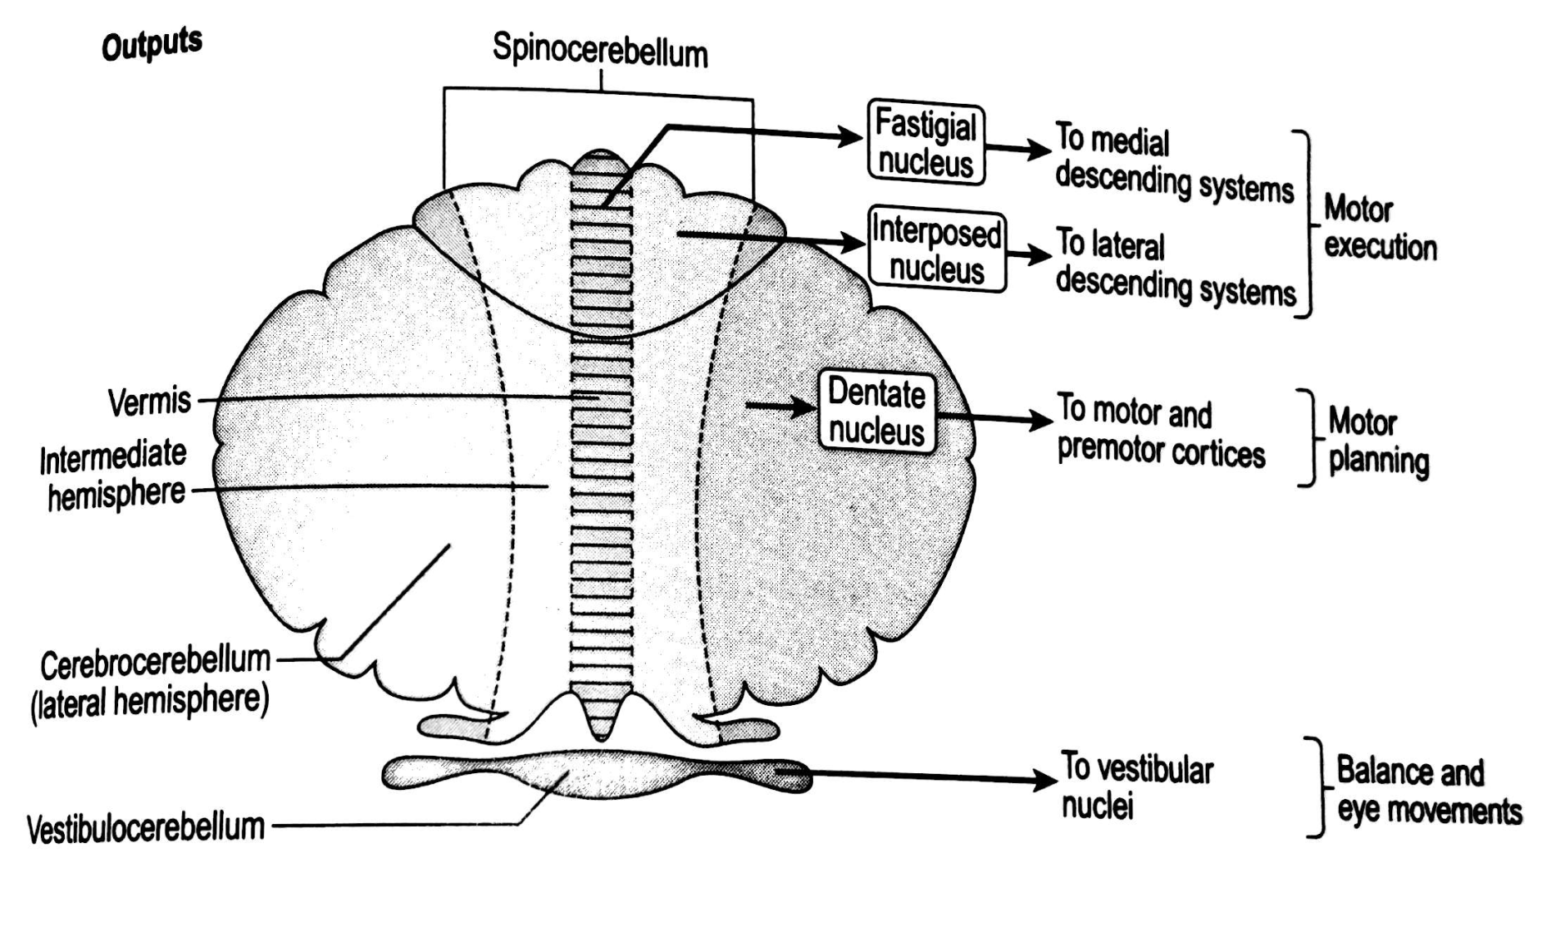

Slide 10
The cerebellum has the connections to carry out this role, receiving inputs from the periphery & from all levels of CNS.
It includes internal feedback- also termed as corollary feedback, mainly concerned to motor planning & forthcoming execution of motion.
It also receives input from external feedback from sensory receptors during movements & compares intended movements with the actual movements as it unfolds.
Therefore movements can be corrected when they deviate from the intended course.

Slide 11
The role of the cerebellum is sometimes described as ‘enriching the movement quality’
It act as movement regulatorory center for the control of motor activity & participating in the construction of synergy.
The cerebellum plays an important role in timing & sequencing of muscle activation during movements, plays vital role in postural control also.

Slide 12
Etiology
Lesion of the cerebellum may result from-
Developmental abnormalities –Hydrocephalous, hypoxia at birth.
Traumatic brain injury
Infections such as encephalitis
Demylinating disease- Multiple sclerosis
Hereditary disease – friedreich’s ataxia
Degenerative disease
Metabolic disease
Vascular insufficiency
Drug abuse & alcohol intoxication.

Slide 13
Clinical signs
Unilateral lesions affect the ipsilateral side of the body
Classically it is described as-
Dysmetria
Dyssynergia
Dysdiadochokinesia
Rebound phenomenon
Tremor
Hypotonia
Dysarthia
Nystagmus

Slide 14
Dysmetria
Dysmetria is demonstrated by inaccurate amplitude of movement and misplaced force & reflects the impairment in timing of muscle force.
There is excessive extent of movement or overshooting(hypermetria) or deficient extent of movement (hypometria) also seen in cerebellar dysfunction.
hypermetric movements may be more marked in small, fast, aimed movements & postural adjustments,while hypometric are seen in slow movements with small amplitude

Slide 15
Cerebellar dysmetria occurs proximally and distally in both upper and lower limbs.
It affects single joint as well as multi joint movements.

Slide 16
Rebound Phenomenon
This phenomenon demonstrate the dysfunction of agonist-antagonist relationship.
When subject is asked to perform voluntary movements against examiner’s resistance and when resistance suddenly released; person is unable to stop the resultant movement.
It leads to overshoot and rebounds excessively.

Slide 17
Disdiadochokinesia
The term denotes difficulty in performing rapid alternating movements such as pronation-supination
The movements are generally clumsy and slowly.
Its shows the irregular pattern of movement when person asked to perform rapid movements.

Slide 18
Tremor
Tremor is oscillating movements about joint due to alternating contractions of agonist and antagonist.
It occurs only during movements not at rest hence called as intention tremor/kinetic/ goal directed tremor.
It is commonly tested through finger to finger test.
Cerebellar tremor is classically marked at the end of movement or during the whole ROM so that it is also called as ‘Terminal tremors’.
A truncal or postural tremor may also present when the person is trying to stand or sit still.

Slide 19
Dyssynergia
It also termed as ‘Movement Decomposition’
It demonstrate a lack of co-ordination between agonist, antagonist & other synergic muscles
It leads to lack of smooth, sequential performance of various components of motion
It is commonly seen in heel-Shin test.
Person with cerebellar dysfunction may show jerky, overshooting movements.

Slide 20
Dysarthia
Speech is slurred and slow.
Person may use prolonged syllables
It is may be due to lack of co-ordination of oral musculature & breathing.

Slide 21
Ataxic Gait
One of the hallmark sign of cerebellar disorder is ataxic gait.
Typical features of this gait is-
Widened BOS
Unsteadiness
irregularity in stepping and direction
Reduced stride length & cadence.
When patients are asked to perform tandem walk patient may finds difficulty to execute.
Tandem walk we can be use for testing and training progression.

Slide 22
Asthenia
In cerebellar lesions Asthenia is very common, in which patient may complain of generalized weakness.
Patient may describe it as a sense of heaviness, with excessive efforts for simple tasks.
Patient may complain -early onset of fatigue in basic activity of daily living.

Slide 23
Hypotonia
The spinocerebellum has been linked to the problem of decreased tone or hypotonicity.
This is mainly because of decrease in excitation from the cerebellar deep nuclei to regions of the brain that excite alpha and gamma motor neurons.
The muscle itself feels less firm to palpation, and when the therapist examines passive range of motion, limb will appear heavy

Slide 24
Deep tendon reflexes are typically normal, But there is often a pendular movement of the limb after the initial muscle contraction response.
During a knee jerk. the leg behaves as a pendulum, that falls by its own weight and oscillates momentarily because of momentum.
Conventional test for hypotonia is to tap the wrists of the outstretched arms, in which the affected limb is displaced through the wider range normal and may oscillate.

Slide 25
This can be seen because of failure of hypotonic muscle to fixate the arm at the shoulder.

Slide 26
Assessment and test Interpretations

Slide 27
Component | Special Tests | Positive
Hypotonicity | Muscle palpation | Reduced firmness
 | Deep tendon reflexes | Pendular
 | Passive shaking of limbs | Limbs move through greater arc of motion than does normal limb
 | Wet footprint Flex one finger only | Print broader on involved side All fingers flex
 | Hold object while conversing | Drops object when distracted
 | Voluntary flexion and extension of knee or elbow supported and unsupported | Ataxic when unsupported controlled when supported

Slide 28
Asthenia | Special Tests | Positive
 | Resting posture | Slack, asymmetrical
 | Maintain arms) in 9O-degree position of flexion or abduction | Arm(s) tire quickly
 | Maximal resisted muscle contraction for major muscle groups | Weaker on involved side or unable to work against resistance. which is normal for size and age
 | Repeat sub maximal muscle contractions. such as, rising on toes, pushups, squeezing tennis ball | Tires quickly

Slide 29
Postural Control | Special Tests | Positive
 | Everyday activities | Tires easily. complains of heaviness
 | Hold limb against pull of gravity | Postural tremor
 | Nudge the patient unexpectedly when sitting or standing | Loses balance easily
 | Stand on one foot or walk backward Standing posture | Loses balance easily Feel apart. trunk flexed slightly. needs to hold for stability, tremors in legs

Slide 30
Dysmetria | Special Tests | Positive
 | Therapist resists client's elbow flexion and release. .. unexpectedly | Arm rebounds
 | slide heel down shin slowly, | Intention tremor
 | place feet on markers when walking | Intention tremor, undershoots. or overshoots Target

Slide 31
Gait Disturbances | Special Tests | Positive
 | March to cadence | Unable to follow rhythm
 | Walk on heels or toes | Loses balance and rhythm
 | Walk clockwise and counterclockwise Walk on uneven ground Typical gait pattern | Stumbles in one direction Cannot compensate and Stumbles Slow, stumbles easily, not rhythmical. step length and height irregular
Disdidokinesia | Tap hand on knee or toes on floor Activities of daily living | Rapidly loses rhythm and range Unable to brush teeth. Stir food, shake salt shaker, pouring water in glass, unable to drink tea/coffee

Slide 32
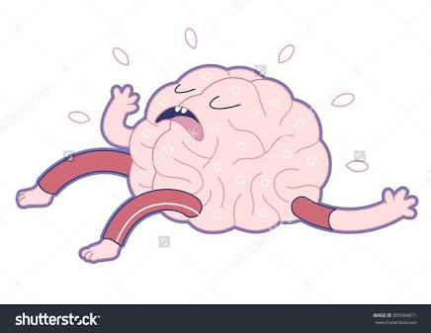
Everyone here is Brain Dead!!!!!!

